Slide 1
LAWS2400 / LAWS8040 – Torts
Topic 1 Lecture 1
Introduction to Torts

Slide 2
Outline: Topic 1 Lecture 1
  Learning logistics
  Defining tort law
  Tort law and other laws
  Theories about the role of tort law in society

Slide 3
Learning logistics Contd.
Pedagogy
Teaching tort law in context:
  How do tort principles relate to what is happening around you / us?
  Can current societal challenges be resolved by applying tort principles?
  How does tort law relate to other branches of law?

Slide 4
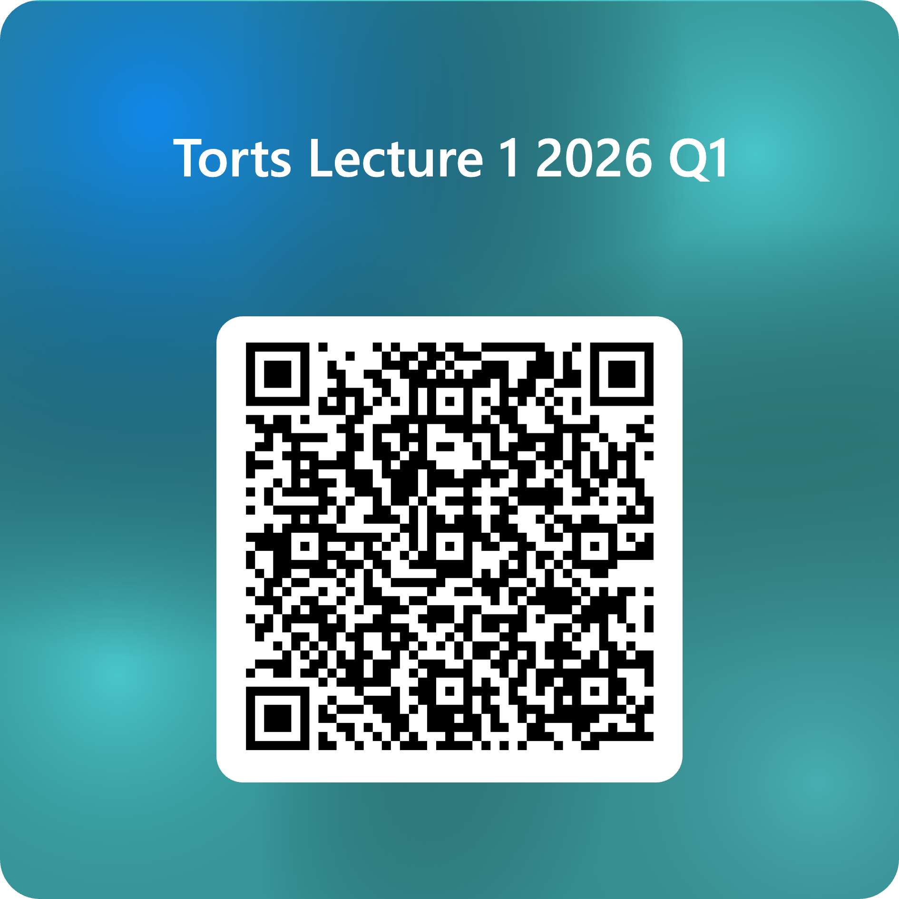
Question 1 – Contemporary Issues
What are some of the major challenges facing society at the moment?

Slide 5
Contemporary Issues – Tort law’s response
Pabai v Commonwealth of Australia (No 2) [2025] FCA 796 (July 2025)
Torres Strait Islanders sued the Australian government, claiming its inadequate climate policies caused rising sea levels that damaged their islands and destroyed their traditional way of life.
Unsuccessful at first instance
Appeal lodged late 2025 and it is currently being heard before the Full Court of the Federal Court (Mortimer CJ and Colvin and Owens JJ) – hearing on 28 August
VID1479/2025: https://www.comcourts.gov.au/file/Federal/P/VID1479/2025/actions

Slide 6
Learning logistics Contd.
Active and interactive learning
Combine court cases, statutes and scholarly writings
Use of practical examples and newspaper reports
Mutually reinforcing role of lectures and tutorials
iLearn discussion forum for torts in news
Lectures:
1 hr F2F
+
1 hr pre-recorded

Slide 7
Learning logistics Contd.
Resources
Textbook: Anna Bunn, Martin Allcock, Simon Allison, Mandy Shircore, Tort Law Principles, (Thomson Reuters, 3rd ed, 2025).
Casebook: See separate block on iLearn
Additional readings
  Carolyn Sappideen, Prue Vines and John Eldridge, Torts: Commentary and Materials (Thomson Reuters, 13th ed, 2021)
  check out iLearn and access via Leganto

Slide 8
Learning logistics Contd.
Assessment
Professional Skills
  20% (ongoing – tutorials during Weeks 2-13)
  See missed tutorial procedure
Practice Based Task
  30% (9 Sep 2026)
  Released about 4 weeks prior
Invigilated exam
  50% (during formal exam period)
  Visit exam FAQs (when available) for further information

Slide 9
Learning logistics Contd.
Expectations
Read beforehand the prescribed materials
Engage constructively with the teaching team and peers

Slide 10
Learning logistics Contd.
Feedback
For any questions, please contact the Unit Convenors and/or your tutor in class
Communication channels
  Questions on unit content:
    In class with your tutor
    In the discussion forum
    In person consultation (see ilearn)
  Private communication is for communications that relate to your personal circumstances. All correspondence is to be directed to Dr Amanda Head.

Slide 11
2. Defining tort law
Tort is derived from a Latin term “tortum” which means “something twisted, wrong or crooked”
Tort law deals with civil wrongs
It lays down rules and principles as to how one should behave about others:
    avoid causing harm to others
    otherwise remedy the harm (e.g., provide compensation)

Slide 12
Defining tort law Contd.
There are several prominent torts such as:
Trespass
Negligence
Defamation
Strict liability
Nuisance

Slide 13
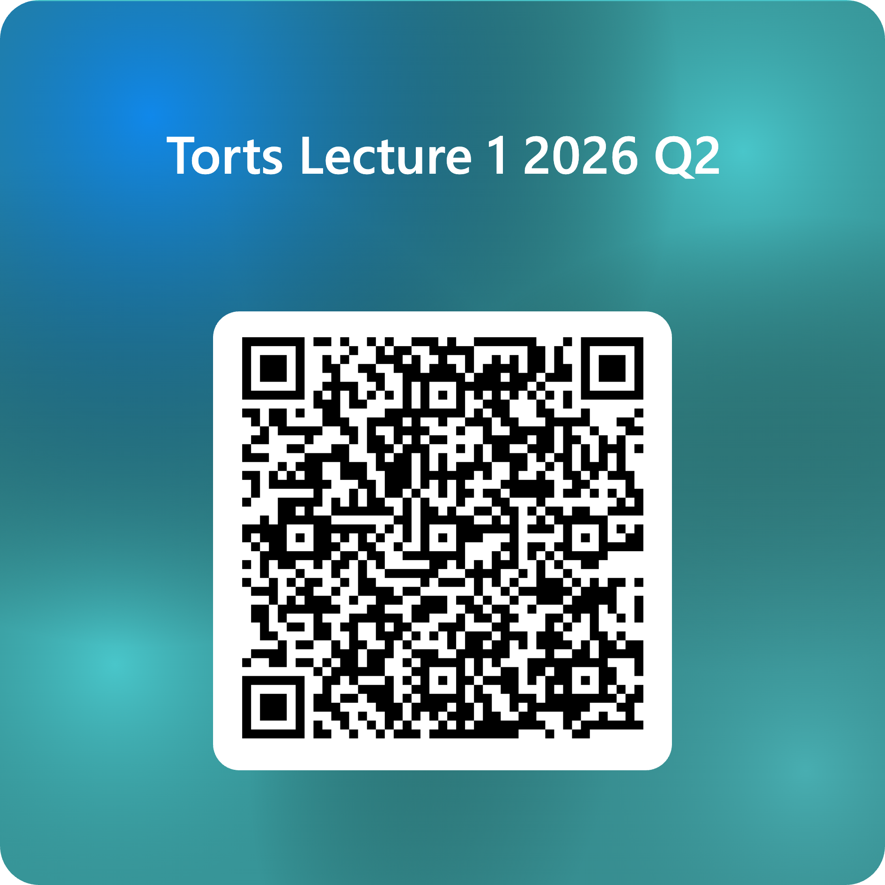
Question 2
Which torts have you heard of prior to today?

Slide 14
Defining tort law Contd.
This then raises a hotly debated question: is it law of tort or law of torts?
John Salmond held the view that law of torts is merely a collection of miscellaneous causes of action
On the other hand, Pollock and Winfield argued that there are a set of fundamental principles that underpin the law of tort – e.g., duties imposed by law owed to all

Slide 15
Defining tort law Contd.
In common law countries, tort law is mostly judge-made law – so cases are critical
However, statutes have increasingly become important for various reasons, e.g., responding to a societal challenge about the price and availability of insurance
The Civil Liability Act 2002 (NSW) is a case in point

Slide 16
Defining tort law Contd.
Although statutes have not completely replaced or codified the common law, they have:
    modified or abolished (some) of the common law
    created new causes of action
Co-existence of cases and statutes is the current life of tort law

Slide 17
3. Tort law and other laws
One way to define tort law is to differentiate it with other laws!
Yet, we should not see tort law as a watertight compartment – rather, it is part of a governance ecosystem to regulate human behaviour
Like other branches of law, it seeks to protect certain rights and interests

Slide 18
Tort law and other laws Contd.
Tort law and criminal law
While civil wrongs are the focus of tort law, criminal law deals with public wrongs (offences)
Yet, the distinction between the two is not always very sharp:
    A certain wrong may amount to both tort and crime (e.g., assault)
    Compensation may be obtained for injuries from crimes

Slide 19
Tort law and other laws Contd.
At the same time, certain broad distinctions can be made between these two branches of law:
 | Tort Law | Criminal Law
Nature of wrong | Private | Public
Main purpose | Compensation | Punishment
Primary principle of justice | Redress / correction | Retribution / deterrence
Action initiated by | Individual | State
Standard of proof | Balance of probabilities | Beyond reasonable doubt

Slide 20
Tort law and other laws Contd.
Tort law and contract law
Both tort law and contract law deal with civil wrongs – certain wrongs may create a cause of action under both (e.g., product liability, contracts for services)
Yet, there are some key differences between the two branches of law

Slide 21
Tort law and other laws Contd.
We can note the following main distinctions between tort law and contract law:
 | Tort Law | Contract Law
Source of duties | Law | Parties, Law
Scope of duties | General (neighbour principle) | Only on specific parties
Relevance of motive | Yes (in some cases) | No
Nature of damages | Unlliquidated | Liquidated
Privity | Not relevant | Generally required

Slide 22
Tort law and other laws Contd.
Tort law and human rights law
Tort law aims to protect the individual’s bodily integrity, reputation and property
This is similar to the purpose of human rights

Slide 23
Tort law and other laws Contd.
In most liberal democracies, there is a Bill of Rights protecting human rights.
Such a Bill of Rights may influence interpretation of existing tort law or contribute to the creation of new tortious actions.
However, there is no comprehensive human rights law in Australia at the federal level (a human rights law exits in ACT, Victoria and Queensland)
Hence, there has been a limited use of tort law to protect human rights

